Slide 1
Sprint Review: SVOT & Renewals
Sprint 5
26 May – 20 June

Slide 2





Sprint Overview
Sprint Numbers
Sprint Links
Key Dates
Weeks
4
Sprint 3 & 4 UAT Testing
02 Jun – 27 Jun
Sprint work Items Delivered
Work Items Delivered
27
Sprint 5 SIT Testing
23 Jun – 27 Jun
Work Items To Still Test
UAT Items Addressed
0
Update ”Grainger Testing” to “Yes” to confirm the work item has delivered the functionality detailed in the Acceptance Criteria
Sprint 5 UAT Testing
30 Jun – 11 Jul
Story Points Completed
62
Dashboard Overview
Release 2 Go Live
01 Sep

Slide 3
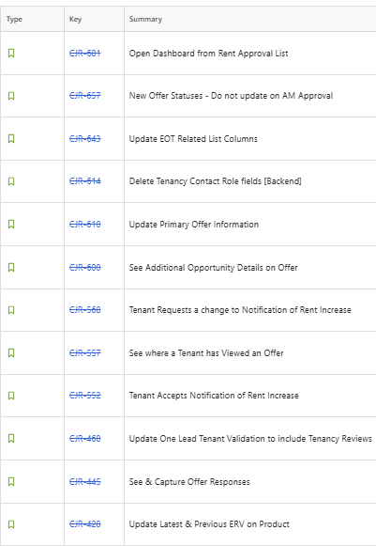
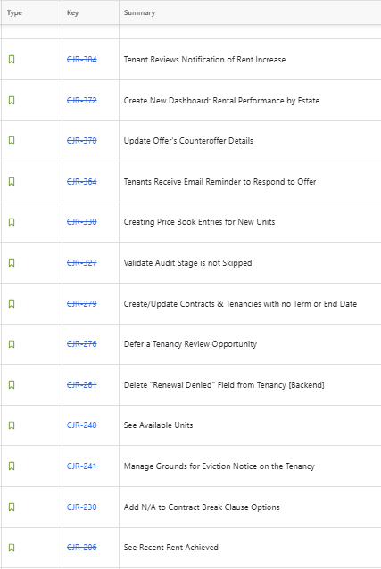
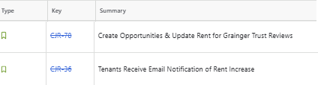
Work Items Delivered

Slide 4
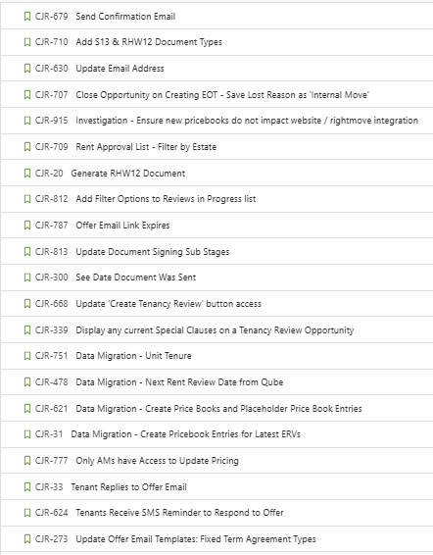
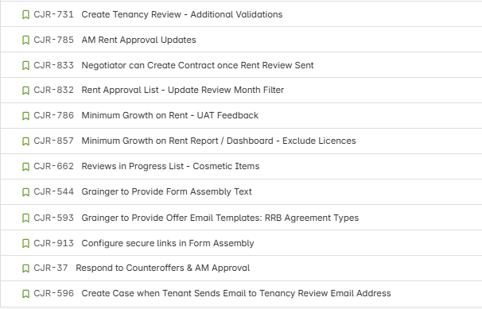
Work Items Planned for Next Sprint

Slide 5
General Items
Items Carried over to next Sprint | Reasons
None
Risk | Contributing factors | Impact | Decisions taken
None
Issue | Contributing factors | Impact | Decisions taken
None
Decision | Description | Date

Slide 6

Thank You

